Slide 1

FACEBOOK DATA ANALYSIS
DEON VICTOR LOBO 4NM17CS054
HARSHIT SUNIL SHIRSAT 4NM17CS068
GAGANDEEP BEKAL 4NM17CS062
Mini Project by:

Slide 2
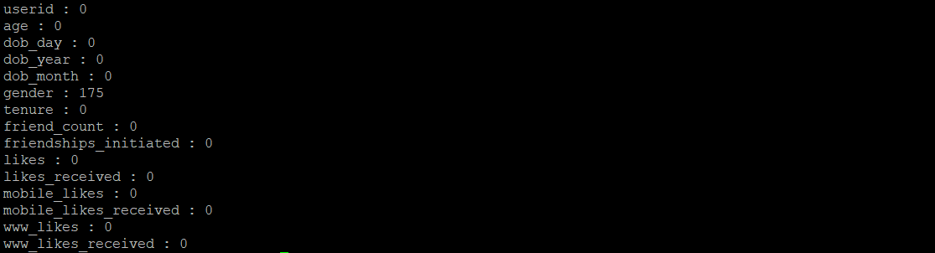
1. Sanity Check:
Command:
export SPARK_MAJOR_VERSION=2
spark-submit SanityCheck.py
Output:

Slide 3
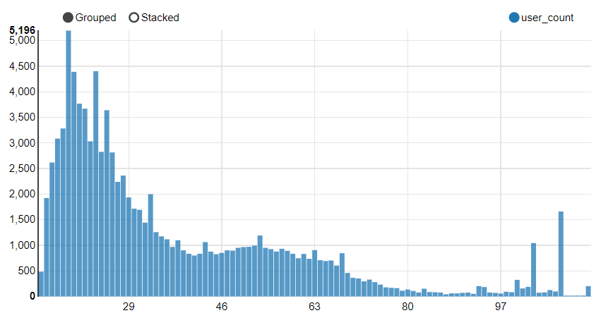
2. Facebook popularity based on ages:
Command: python map_reduce1.py -r hadoop --hadoop-streaming-jar /usr/hdp/current/hadoop-mapreduce-client/hadoop-streaming.jar hdfs:///tmp/facebook_data/pseudo_facebook.csv
Age wise distribution of users:

Slide 4
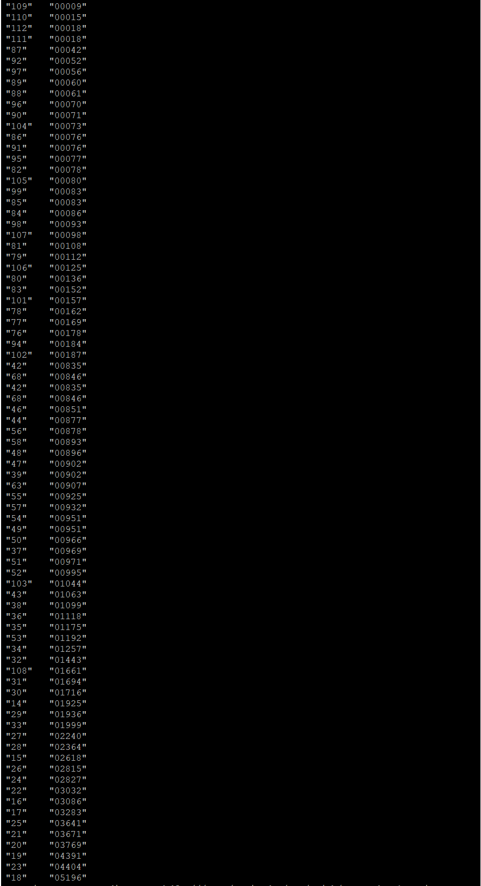
Output: (Age,Count)

Slide 5
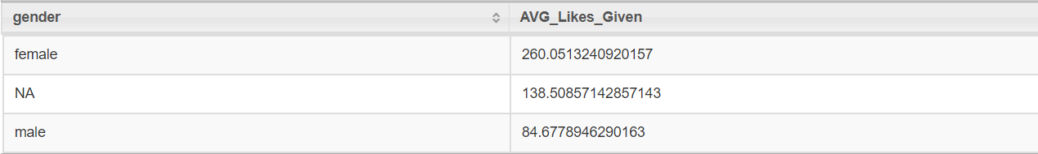
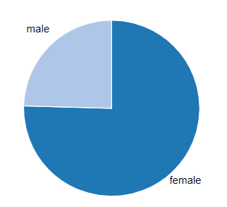
3. Likes Given:
CMD: apache-drill-1.12.0/bin/drillbit.sh start -Ddrill.exec.http.port=8765
Query 1: SELECT gender,avg(likes) AS AVG_Likes_Given
FROM hive.facebook_db.facebook
GROUP BY gender
ORDER BY AVG_Likes_Given DESC
Output: gender vs likes given :

Slide 6
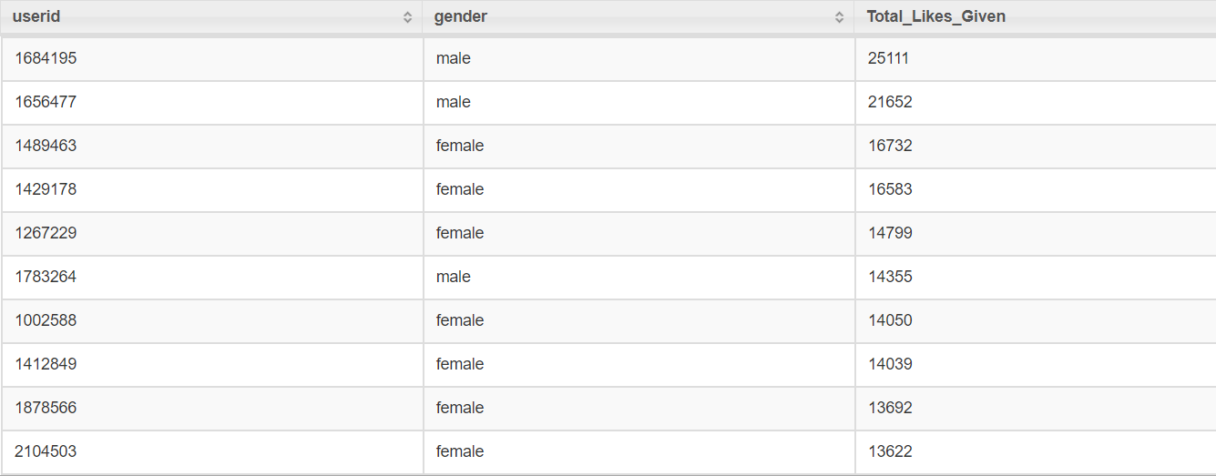
Query 2: SELECT userid, gender, likes AS Total_Likes_Given
FROM hive.facebook_db.facebook
ORDER BY Total_likes_Given DESC LIMIT 10
Output : Top 10 users with most likes received

Slide 7
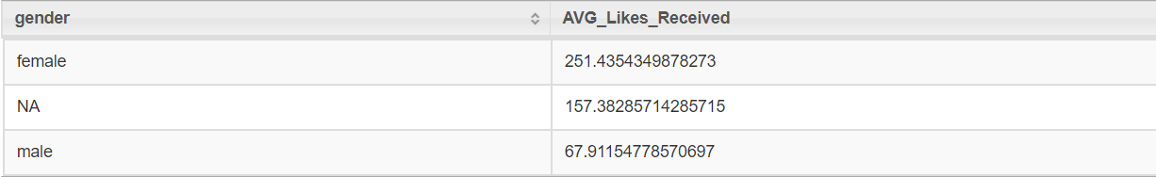
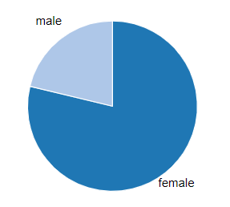
4. Likes Received:
CMD: apache-drill-1.12.0/bin/drillbit.sh start -Ddrill.exec.http.port=8765
Query 1: SELECT gender,avg(likes_received) AS AVG_Likes_Received
FROM hive.facebook_db.facebook
GROUP BY gender
ORDER BY AVG_Likes_Received DESC
Output: gender vs total likes received :

Slide 8
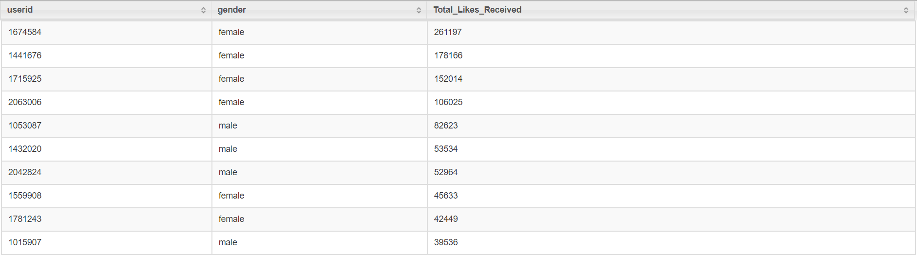
Query 2: SELECT userid, gender, likes_received AS Total_Likes_Received
FROM hive.facebook_db.facebook
ORDER BY likes_received DESC
LIMIT 10
Output : Top 10 users with most likes received

Slide 9
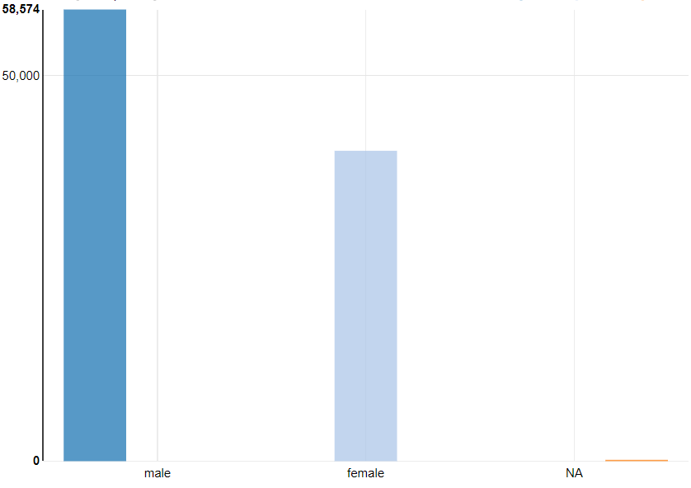
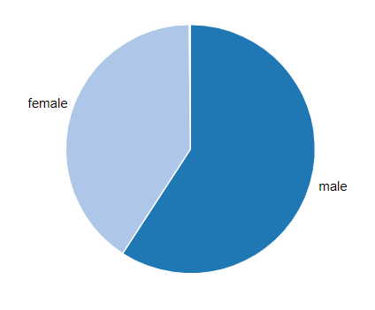
5. Gender Count:
Output:
+------+-----+
|gender|count|
+------+-----+
| male |58574|
|female|40254|
| NA | 175 |
+------+-----+

Slide 10
6. Likes Split Up:
Query 1:
SELECT gender,avg(mobile_likes) AS mobile_likes_given, avg(mobile_likes_received) AS mobile_likes_received, avg(www_likes) AS www_likes_given, avg(www_likes_received) AS www_likes_received
FROM fb
WHERE gender <> "NA"
GROUP BY gender
Output:

Slide 11
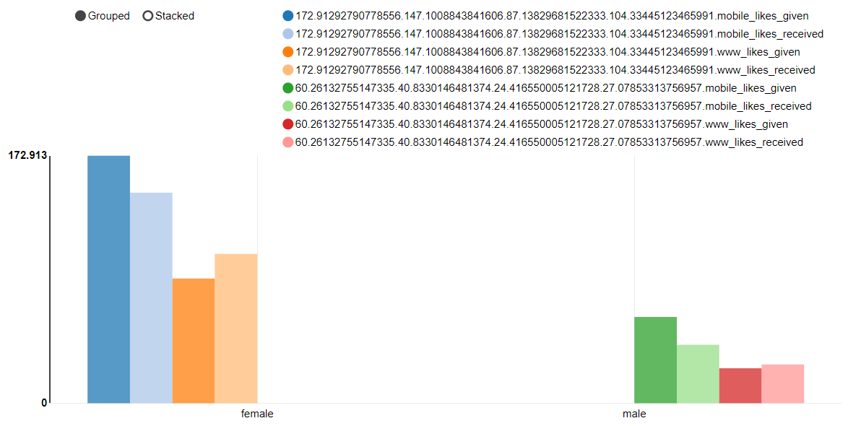

Slide 12
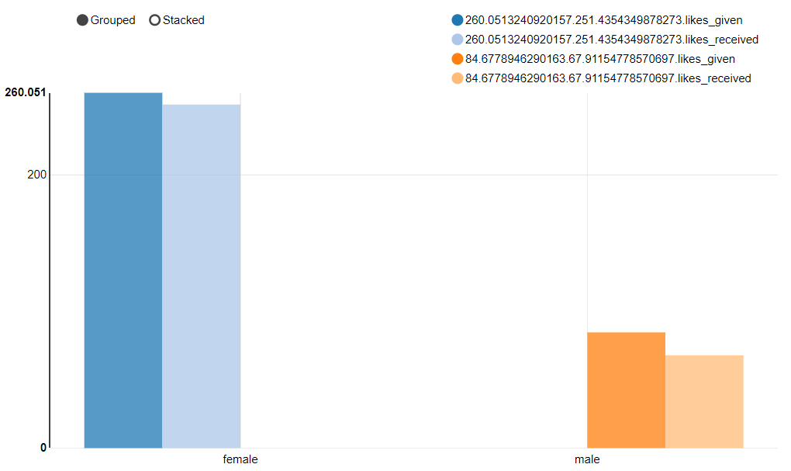
Query2:
%sql
SELECT gender,avg(likes) AS likes_given ,avg(likes_received) AS likes_received
FROM fb
WHERE gender <> "NA"
GROUP BY gender
Output(Likes vs Likes Recived by gender):

Slide 13
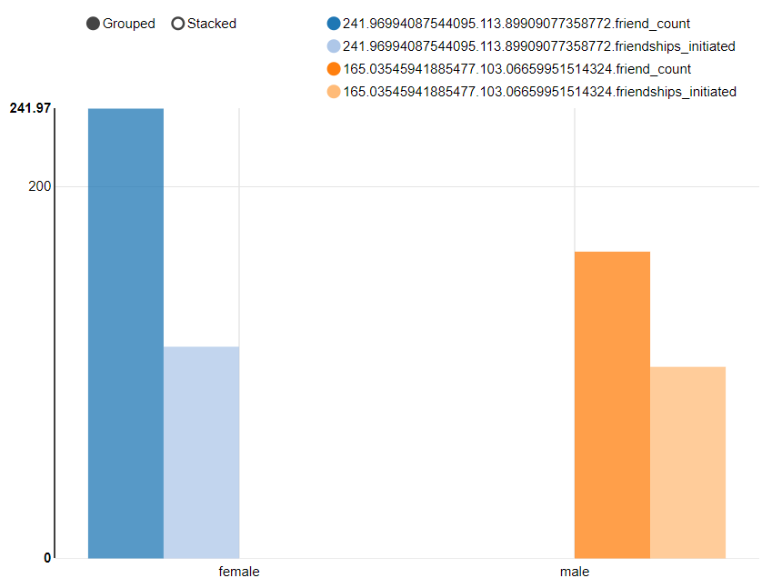
7. Friends Counts & Friendships initiated:
Query :
SELECT gender,avg(friend_count) AS friend_count ,avg(friendships_initiated) AS friendships_initiated
FROM fb
WHERE gender <> "NA"
GROUP BY gender
Output : (Friends Count vs Friendships Initiated)

Slide 14
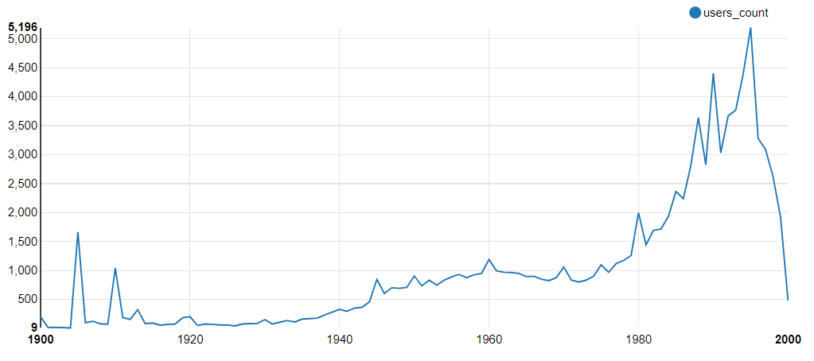
8. Users w.r.t birth year:
Query: SELECT dob_year,count(userid) AS users_count
FROM fb
GROUP BY dob_year
Output:

